Slide 1

Arrays In Java
R.Vaishnavi

Slide 2
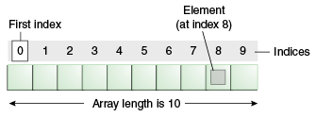
What is Array?
An Array is a collection of similar type of elements.
In Java Array is an object.
This means an array can have methods and attributes, such as the length of the array.
Array elements are always stored in consecutive memory blocks.
Array in Java is index-based, the first element of the array is stored at the 0th index, 2nd element is stored on 1st index and so on.
In Java array index range from 0 to n-1.
Here n is the length of the array.

Slide 3
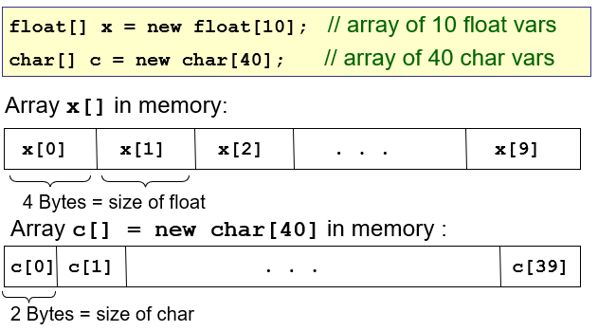
In java the length of the array is fixed when it is created. It cannot be changed.

Slide 4
Types Of Arrays
In java Arrays are 3 types
1
One-dimensional Array
2
Multi-dimensional Array
3
Jagged array

Slide 5
One-dimensional Array (1D)
A one-dimensional array can be visualized as a single row or a column of array elements
Declaration: We can declare 1D array in 2 ways.
Static type declaration:
Syntax: datatype array_name [ ]= {values};
int rank[ ]={1,2,3,4,5};
2) Dynamic type declaration:
Syntax: datatype array_name [ ]= new datatype[size];
int rank[ ]= new int[5];

Slide 6
Accessing: We can access 1D array in 3 ways.
Using Indexing :
int a[ ]=new int[3]; //declaration
a[0]=10; //initialization
a[1]=20;
a[2]=30;
//printing array
System.out.println(a[0]); //10
System.out.println(a[1]); //20
System.out.println(a[2]); //30
2) Using For loop : 3) Using For-each loop:
for(int i=0; i< a.length; i++) for(int i : a) {
{ System.out.println(i);
System.out.print(a[i] + " "); }
}

Slide 7
Multi-dimensional Array (2D)
A Multi-dimensional array can be arranged in rows and columns of array elements like a matrix.
Declaration: We can declare 2D array in 2 ways.
Static type declaration:
Syntax: datatype array_name [ ][ ]= {{values},{values}};
int a[ ][ ]={{1,2,3},{2,4,5},{4,4,5}};
2) Dynamic type declaration:
Syntax: datatype array_name [ ][ ]= new datatype[size][size];
int a[ ][ ] = new int[3][3];

Slide 8
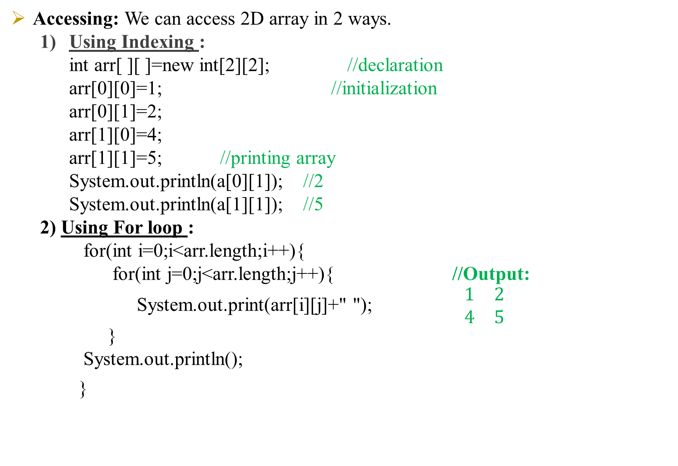
Accessing: We can access 2D array in 2 ways.
Using Indexing :
int arr[ ][ ]=new int[2][2]; //declaration
arr[0][0]=1; //initialization
arr[0][1]=2;
arr[1][0]=4;
arr[1][1]=5; //printing array
System.out.println(a[0][1]); //2
System.out.println(a[1][1]); //5
2) Using For loop :
for(int i=0;i<arr.length;i++){
for(int j=0;j<arr.length;j++){ //Output:
System.out.print(arr[i][j]+" "); $\begin{matrix}1 & 2 \\ 4 & 5\end{matrix}$
}
System.out.println();
}

Slide 9
Jagged Array
If we are creating odd number of columns in a 2D array, it is known as a jagged array.
In other words, it is an array of arrays with different number of columns.
Syntax: data_type array_name[][] = new data_type[n][ ]; //n: no. of rows
array_name[] = new data_type[n1] //n1= no. of columns in row-1
array_name[] = new data_type[n2] //n2= no. of columns in row-2
array_name[] = new data_type[n3] //n3= no. of columns in row-3
array_name[] = new data_type[nk] //nk=no. of columns in row-n

Slide 10

//declaring a 2D array with odd columns
int arr[ ][ ] = new int[3][];
arr[0] = new int[3];
arr[1] = new int[4];
arr[2] = new int[2];
//initializing a jagged array
int count = 0;
for (int i=0; i<arr.length; i++)
for(int j=0; j<arr[i].length; j++)
arr[i][j] = count++;
//printing the data of a jagged array
for (int i=0; i<arr.length; i++){ // Output:
for (int j=0; j<arr[i].length; j++){
System.out.print(arr[i][j]+" ");
}
System.out.println();
}

Slide 11
Advantages
Easier to store elements of same data type.
Fast random access for efficient data manipulation.
Optimal memory usage with contiguous storage.
Simple and user-friendly.
Predictable performance with a fixed size.

